Slide 1
Previous lecture
Both prices and wages sticky
Changed loss function depends on losses associated wiht wage deviations
Stabilizing wage and inflation is important but there is a trade off

Slide 2
Optimal policy
Flexible wages => stabilize price level
Flexible prices => stabilize wage level
Wages & prices sticky => efficiency no longer possible => policy tradeoff
Structural parameters in weights for wage and price inflation determine optimal policy

Slide 4
Problem
Too complicated
Structural parameters difficult to identify
Output gap unobservable
Model unknown

Slide 5
Special case

Slide 6
Optimal policy as before
Stabilize the composite price level with the derived weights
=> output is stabilized as before
But: Wage inflation should be included in the target variable

Slide 7
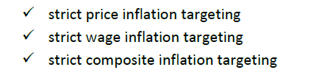

Simulations with simple rules

Slide 9
Results
Wage inflation important
Strict price inflation targeting suboptimal
Strict better than flexible

Slide 10
Further extensions
Open economy
  Prices on tradables
  Price discrimination or not, pricing to market or law of one price
  Local currency or producer currency pricing
  Small/large economy
  Policy target variable
  Phillips curve, Dynamic IS Curve, Policy rule

Slide 11
Inflation targeting in practice
Inflation measure, different aspects
Theory: depends on price stickyness
Practice
  CPI
  GDP deflator
  other indexes
    asset prices
    wages

Slide 12
CPI
Narrow measure
Both domestic and import prices
Nondurables, durables, services
  durables prices, housing prices, interest rates
Published monthly
Well-known
Done for other purposes (compensation, cost of living)

Slide 13
Conclusion
Wages are most important under reasonable parameterization according to Mankiw & Reis
Compare with Erceg, Henderson & Levin (2000)
Wages should be included in target

Slide 14
Transmission mechanism
Policy rate
  Short & long market rates
  Credibility & expectations
  Interest rates and demand
    Consumption
    Investments
    Asset prices
    Exchange rates and trade
  Public sector & fiscal policy
  Effects with considerable delay
    2 year foresight

Slide 15
Decisions based on forecasts
Models
  NK model, general equilibrium
  Riksbank as example
    RAMSES, NK interpretation
    Supported by other models, time-series models (VARs), ”without interpretations”, sectoral experts
    Forecast horizon
      RAMSES long horizon
      Supporting models shorter horizon
Model uncertainty
  What model?
  Rational expectations and changing models
  Different opinions

Slide 16
Major alternatives
2nd generation neokeynesian models with rational expectations, forward-looking behavior, not fully microfounded big size
NK models, fully microfounded small size
time-series models, no theory
alternative theories

Slide 17
RAMSES – DSGE model
NK model
Bayesian econometrics
Small model – 12 data variables
Open economy
Sticky prices, wages, import prices, different markups
Hours worked, no unemployment
Simple fiscal policy, no policy rule
Estimated Taylor rule

Slide 18
Extensions in RAMSES
Habit formation, backward-looking consumption
Phillips curve backward and forward looking
Adjustment costs in investments (capital stock adjustment)
CPI-X (”core”) inflation
Taylor rule for policy
Ongoing research

Slide 19
Target variables: Inflation
Inflation measure
  CPI or CPI-X or?
  Wages?
  Producer prices?
CPI deficiencies
  Too narrow measure
  Quality changes, 2% is stable price level?
  Interest rates, capital gains, durables

Slide 20
Target variables: Output gap
Measure of potential or trend
Mechanic or based on theory
Different mechanical measures
  Hodrick-Prescott (HP gap)
Theoretical measures model dependent
  Flex-price gap
No consensus

Slide 21
Alternative theories
Hysteresis models
  Temporary shocks -> Permanent effects
  Insider-outsider
Near-rational expectations
  Akerlof’s Phillips curve
  Mankiw/Reis inattentive agents
Friedman’s rule - zero interest rate
Inflation tax

Slide 22
Policy environment
Legislation (commitment)
Central bank independence
  Credibility
    Transparency
    Commitment
    Evaluation
      by central bank
      independent
      loss function?
  Accountability
    responsible to the parliament
    official target, measurable

Slide 23
Legislation
Example: Sweden
Central bank law
  Price stability
  Independent central bank
Target 2% determined by the central bank
Flexible inflation targeting determined by the central bank

Slide 24
Different in other countries
UK
  ultimate target and specific target by parliament
USA
  only ultimate targets in Federal Reserve Act
ECB
  ultimate target and specific target set by governing council of ECB

Slide 25
Problems with accountability
Specific targets not determined by principal but by agent
Targets difficult to measure

Slide 26
Independence
The independence of the Executive Board is also emphasized in the Sveriges Riksbank Act, which states that the members of the Executive Board may neither seek nor take instructions when fulfilling their monetary policy duties.

Slide 27

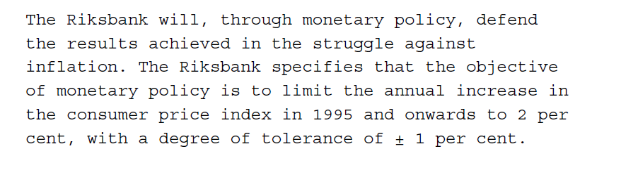

Legislation

Slide 28
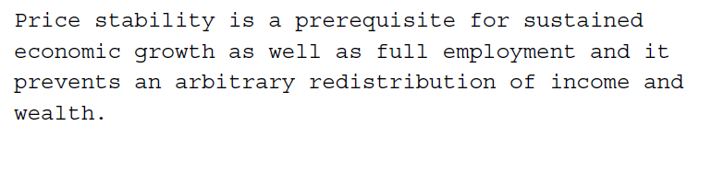
also said

Slide 29

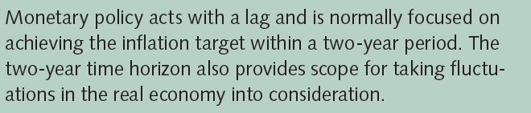
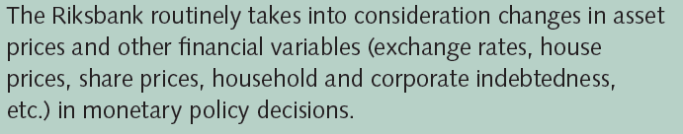
Law & CB July 2008

Slide 30
Flexibility
The two-year horizon can be interpreted as a restriction as to how much consideration can normally be given to real economic developments, a restriction which – like the specified inflation target – the Riksbank has imposed on itself to make the target of maintaining price stability credible

Slide 31
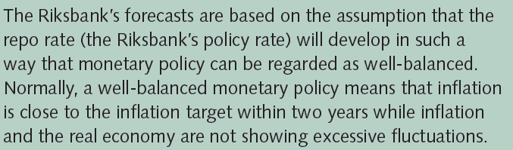
and…

Slide 32
1993 & 2008
Price stability is a prerequisite for sustained economic growth as well as full employment and it prevents an arbitrary redistribution of income and wealth.
Also, monetary policy does not have the task of, and cannot be used for, achieving lasting higher employment or growth. What monetary policy can achieve, however, is to ensure an inflation rate which over a number of years is well in line with the inflation target and to contribute to dampening the fluctuations in the real economy. In this way, monetary policy can create good conditions for an efficiently functioning economy and a favourable, stable macroeconomic development.

Slide 33
Evaluation
Inflation close to target?
  What inflation measure
    Confusion in Sweden
Loss function?
  What measures?
  What loss function?
Accountability
  Who evaluates and how?

Slide 34
Evaluation: Forecasts
Are forecasts good or bad?
  Short-run models
    Provide better starting points for structural model
    VAR models
  Structural models
    NK models still in developing phase
    Model uncertainty
    How structural? Identification issues
Forecast experience

Slide 35
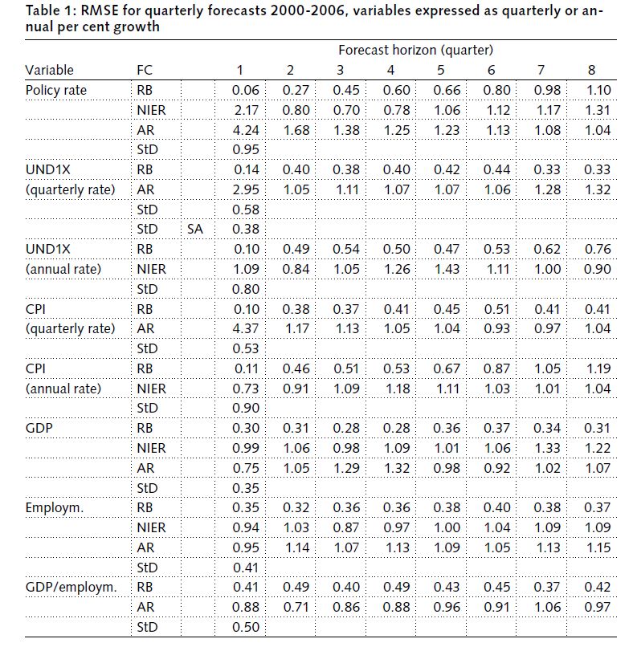

Slide 36
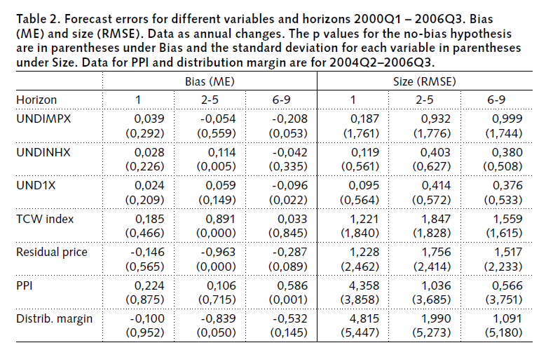
Forecast performance

Slide 37
Policy evaluation
Target not so explicit
How to interpret ”flexible targeting”
Practice vs theory
  Theory: efficient allocation
  Practice: low inflation
Inflation target: CPI but including wage inflation advantageous: should one ignore wage inflation in evaluation?

Slide 38
Inflation targeting era
Inflation low
Inflation less volatile
Output growth high
Output volatility lower
Does this depend on inflation targeting?
  Compare countries
    Denmark vs Sweden
Experts on Sweden, Giavazzi & Mishkin

